Slide 1
Final Project
Group Members:
1.C.Aashrith
2.Ananda Ganesh
3.Dawna Grace Raj Sathia

Slide 2
Problem Statement
Every year 3.5-7 Billion Trees are cut out of which 10% are cut for the manufacture of Wood based Products which approximately results in half a billion trees.
Various enterprises and organizations will be needing various wood based products.
Even if we are able to convert a fraction of customers who buy wooden products into buying products that involve alternate resources like bamboo , we will be saving millions of trees.
Since each tree typically takes over 20 years to fully grow , saving each and every tree counts

Slide 3
As trees have plenty of uses that include giving out Oxygen , Taking in CarbonDioxide along with other toxic gases such as Sulphur dioxide , Protecting them will really help us in the long term.
The higher the amount of people help in this cause , the higher of trees can be saved.

Slide 4
Approach
Every time any enterprise orders any wood based products , the order is processed through an Ecoguard who helps the clients understand the importance of protecting trees.
The eco guard then sends a detailed analysis of the amount of money and wood spent by the enterprise over the past 5 years and what the respective values would have been if alternative resources such as bamboo would have been used.
The client is then sent an order consisting of the same product made of alternative resource along with the cost thus helping the client change the order saving them a lot of money along with protecting the environment.
If a client does not want to change the order they were suggested , they always have an option of donating money which will be spent towards planting new trees.

Slide 5
Important roles
An Employee(Provider) who places a request to the designer .
A designer who fetches the price for the product and its type from a list of suppliers and then places an order based on the requirements.
An ecoguard who receives the accepted orders from the Manager and then provides an alternative for the products asked.

Slide 6
Object Model for Ecoguard

Slide 7
Use Cases
A central Admin creates login for multiple enterprises , who can then logins in to the created user IDs and create various Organizations logins .
An employee representing the organization then sends a request to the company Designer based on the requirements they have have for the company asking how much wood and the price it might cost.
The designer then gets the products from a list of suppliers , who then chooses one of the suppliers based on the client requirement (Rating or Cost) who then sends an order to the Manager .
The Manager then forwards the order to the eco guard who then emails the Manager a detailed Analysis of the clients past 5 years orders along with the amount they have spent and what they would have saved if environmental alternatives would have been used.

Slide 8
The Manager then goes through the Analysis sent by the eco guard and then thinks about changing the order to an alternate resource suggested by the eco Guard thus saving trees and money.
Every client who has chosen to donate or take up the suggested order by the eco guard is displayed on the Environmental Website – Green-Clique. The URL to the Website is : Green-clique.appspot.com

Slide 9
Core Functionalities
The Core Functionalities that we have implemented during our project
Charts – Analysis for the Ecoguard.
Mail – To send an analysis with data pertaining to the enterprise with a mail that consists of charts attached in the PDF attached.
Multi Threading : Implemented multi threading using the Swing worker class that helps by running data in the background and notify us when the processing is successfully completed.
Website : http://green-clique.appspot.com/.
Network to Network Communication : Suppliers from Chicago can get Stock from Suppliers from boston GODOWN .

Slide 10
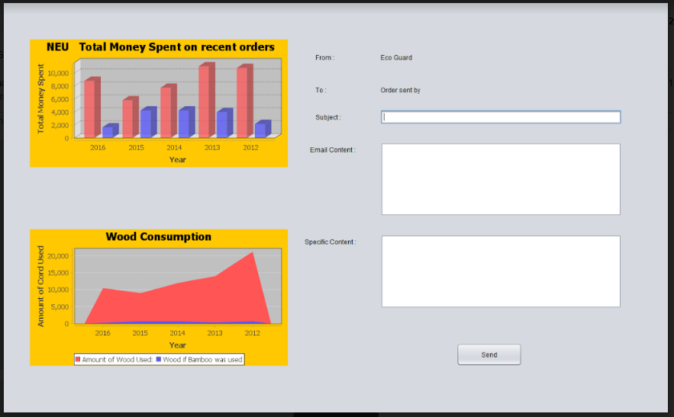
Charts

Slide 11
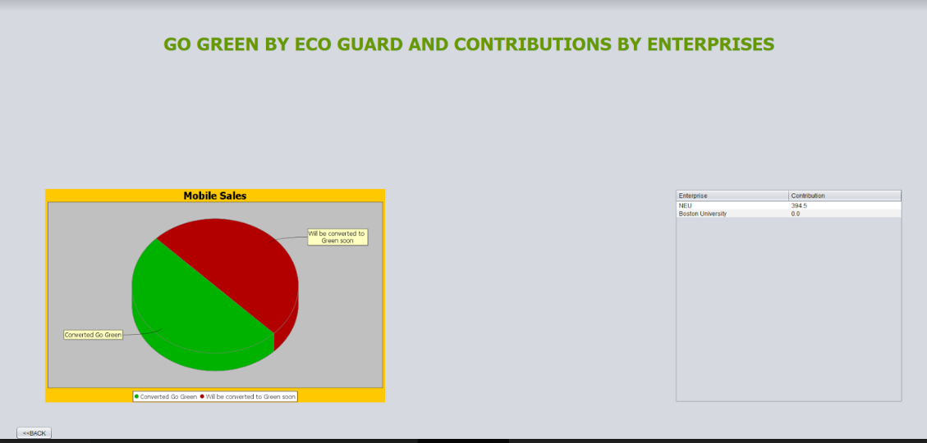
Charts

Slide 12
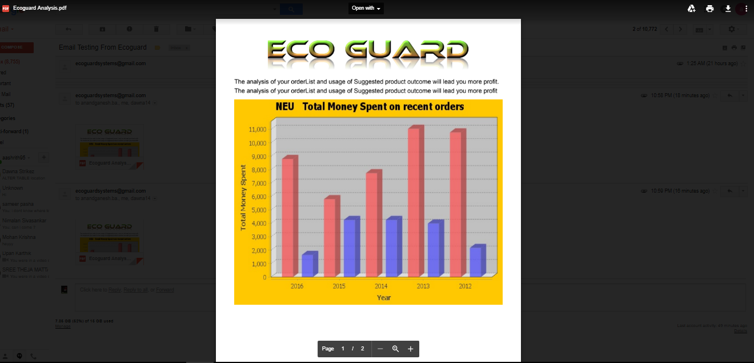
Email

Slide 13
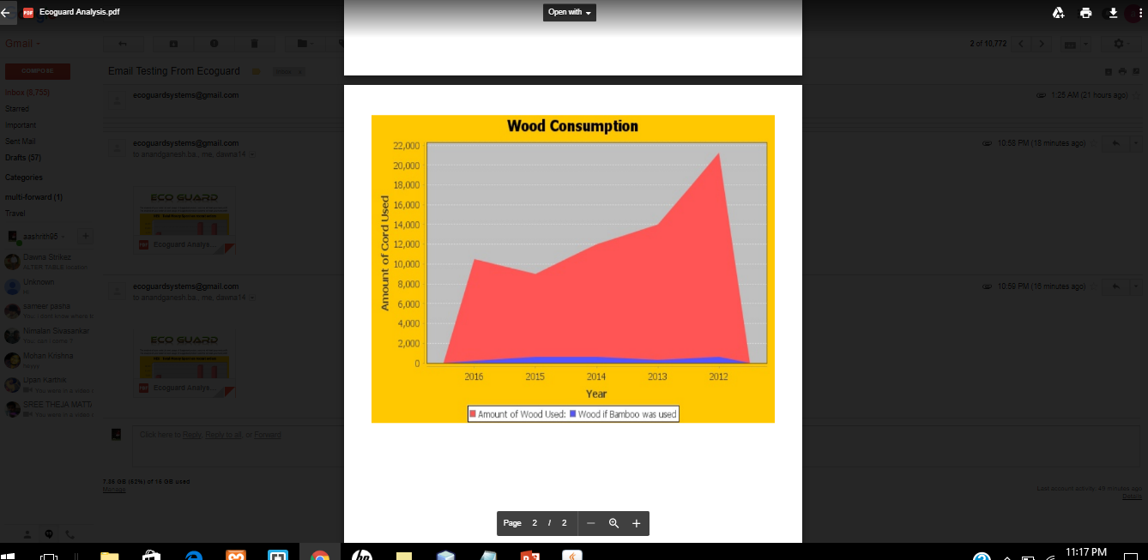
Email

Slide 14
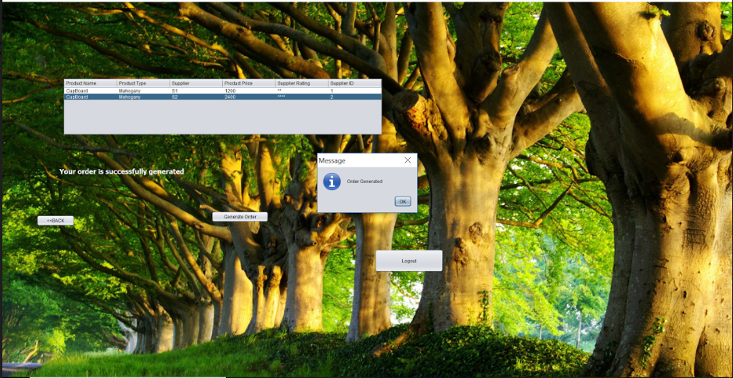
MultiThreading
We have used Multithreading to use a thread that runs on it own in the background and processes data and updates the UI after its Done.

Slide 15
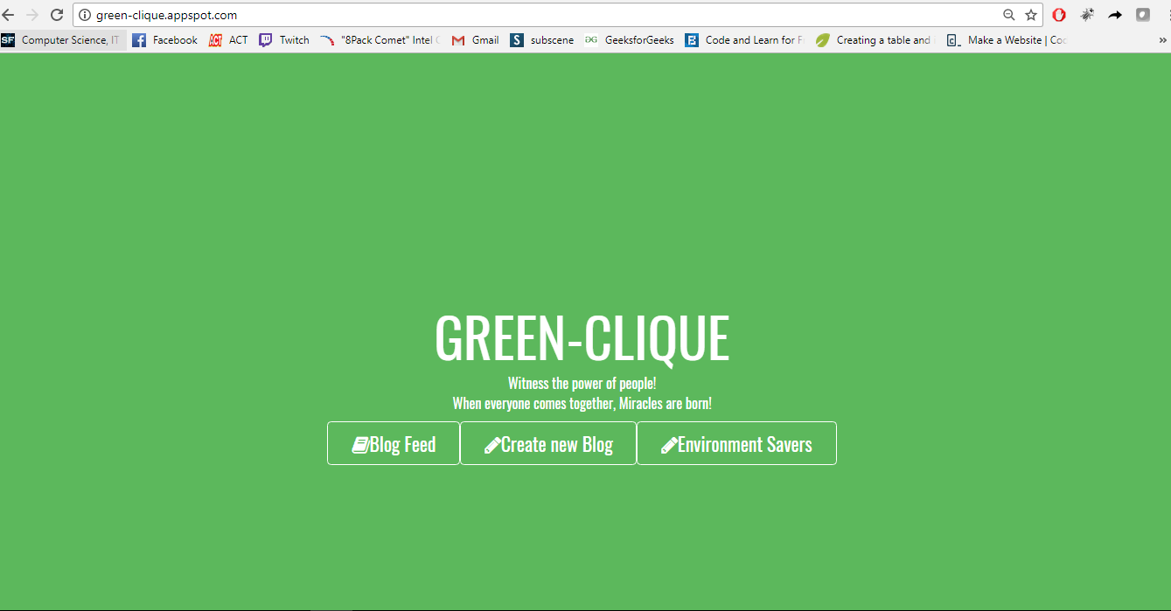
Green Clique Website

Slide 16
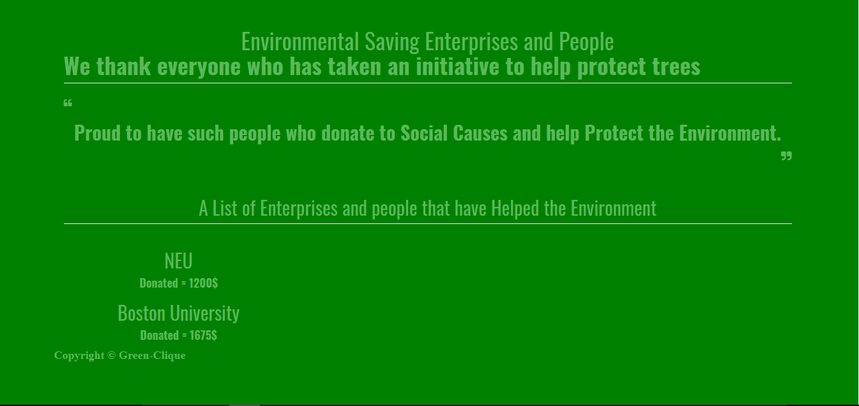
Our Website: http://green-clique.appspot.com/

Slide 17
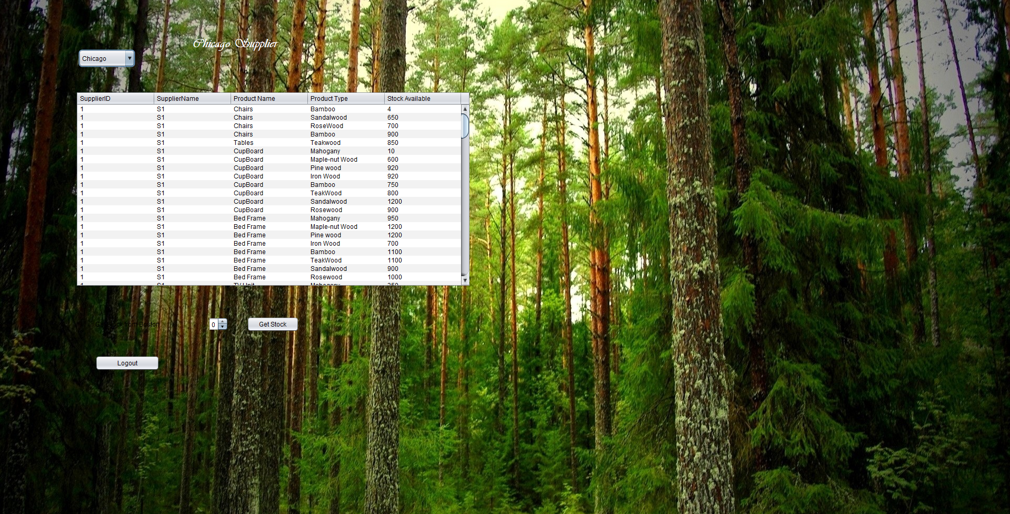
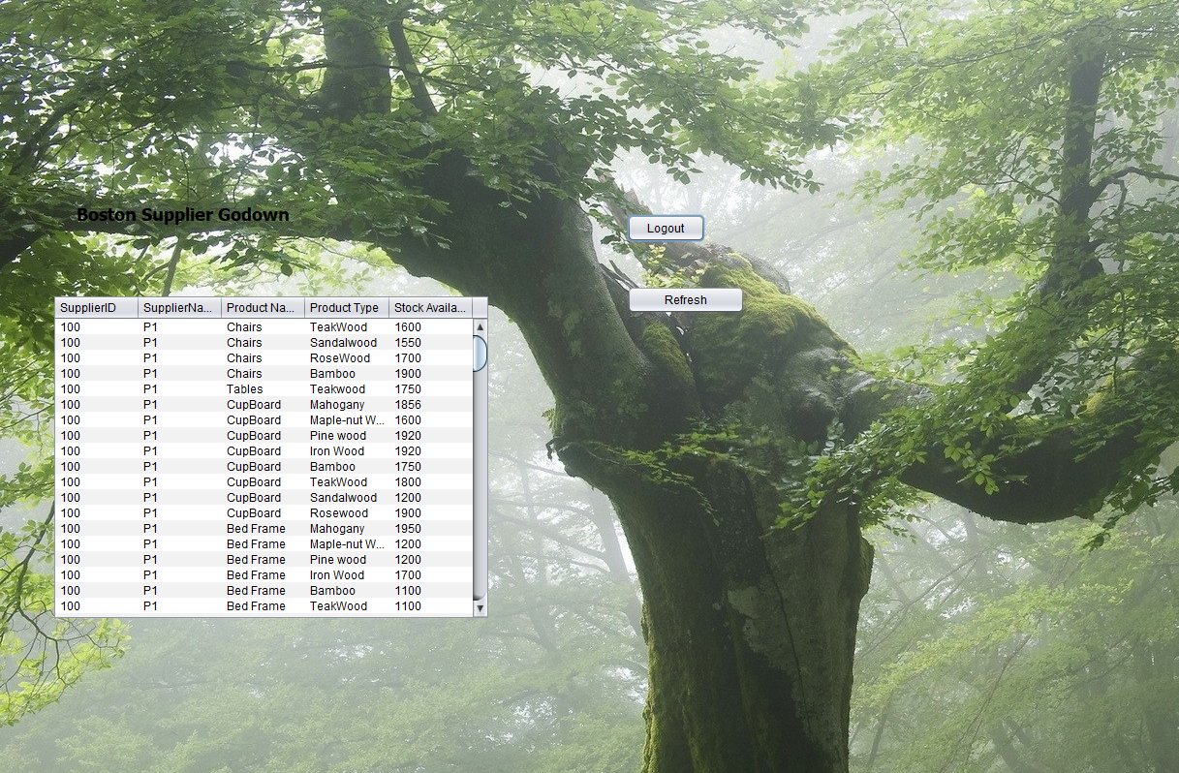
N-N Communication

Slide 18
Thank You

